Slide 1
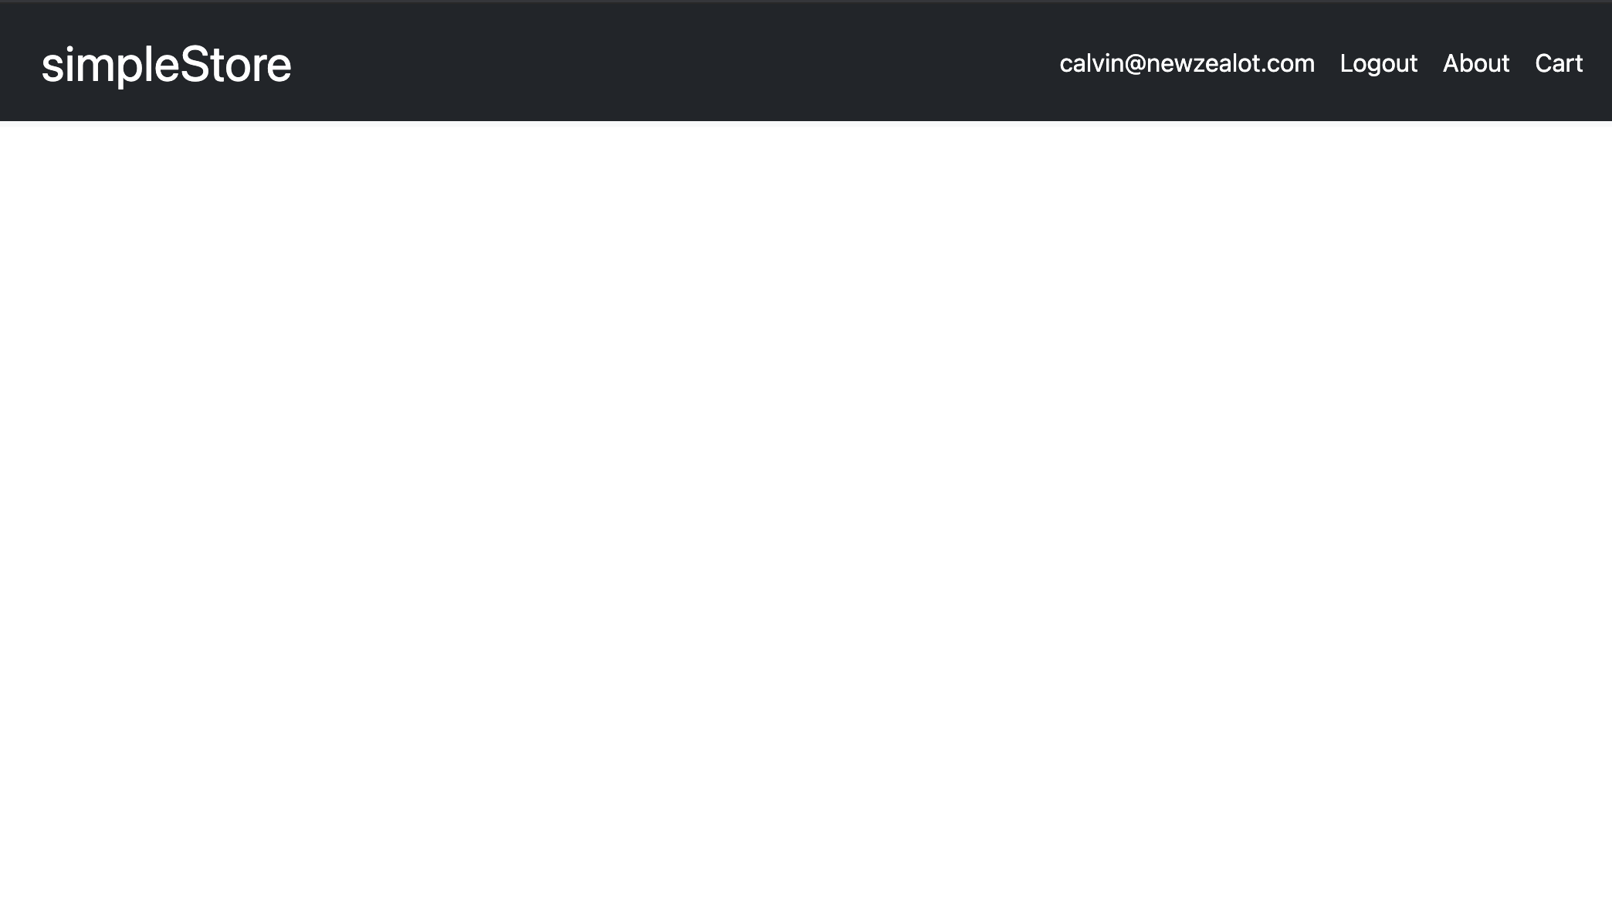
simpleStore
A simple eCommerce store for individuals to sell homemade goods
By Calvin Chew Ing Hao

Slide 2
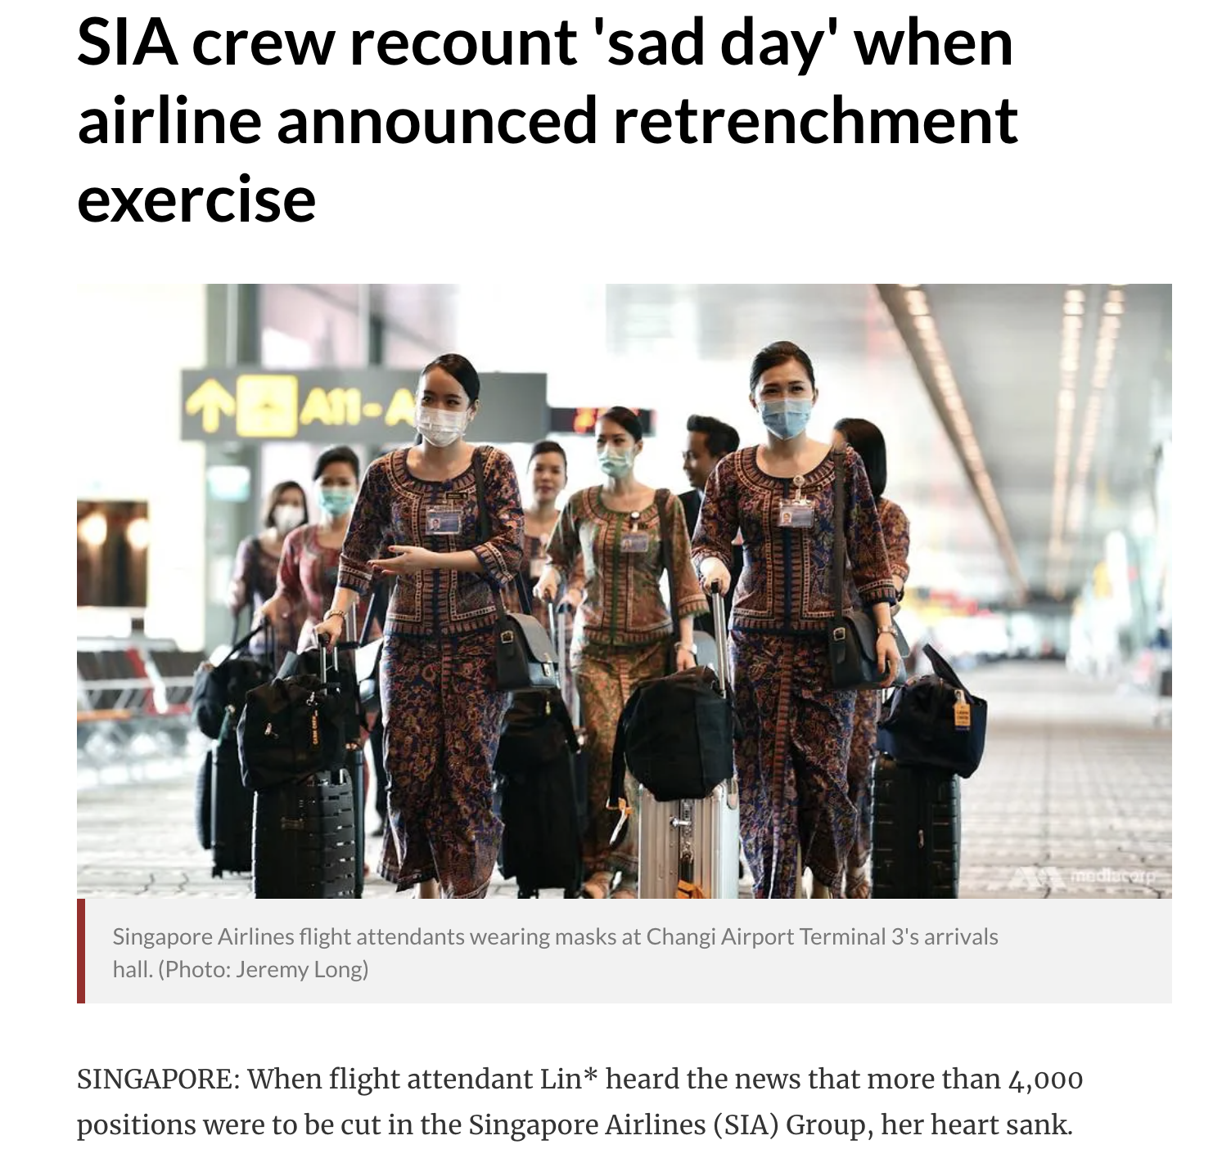
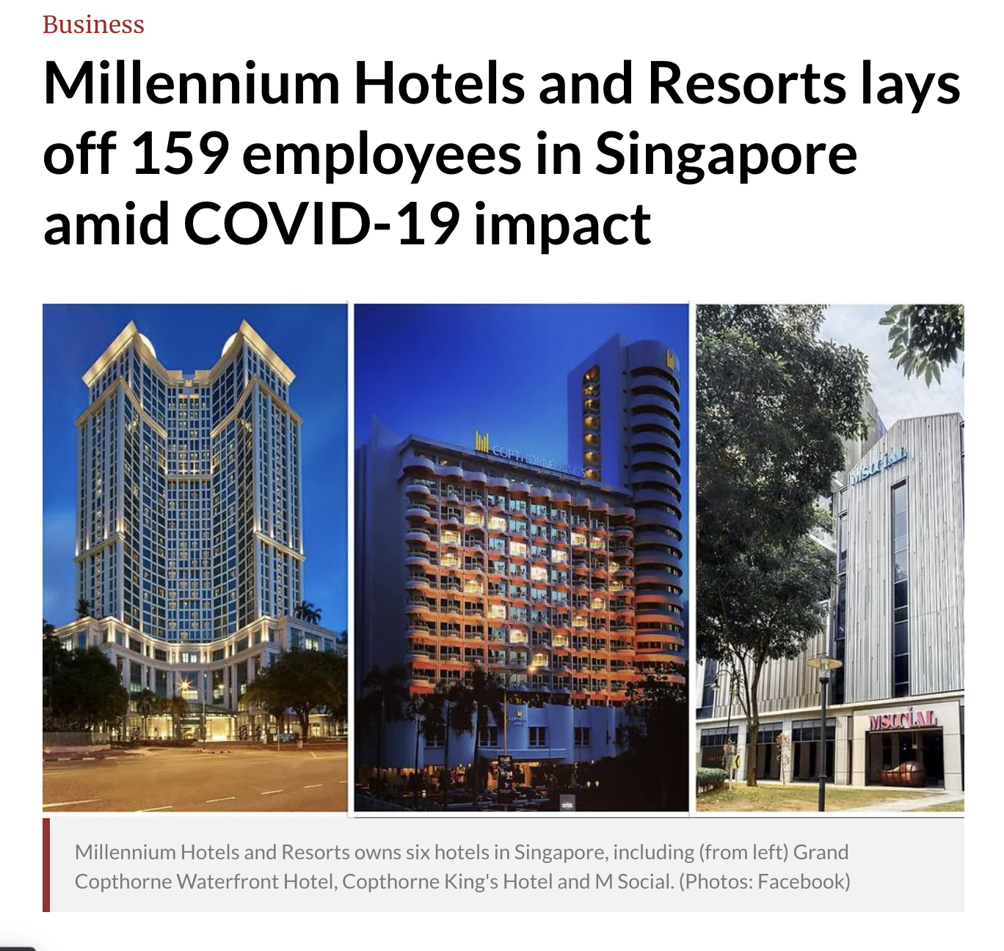
Times are hard…

Slide 3
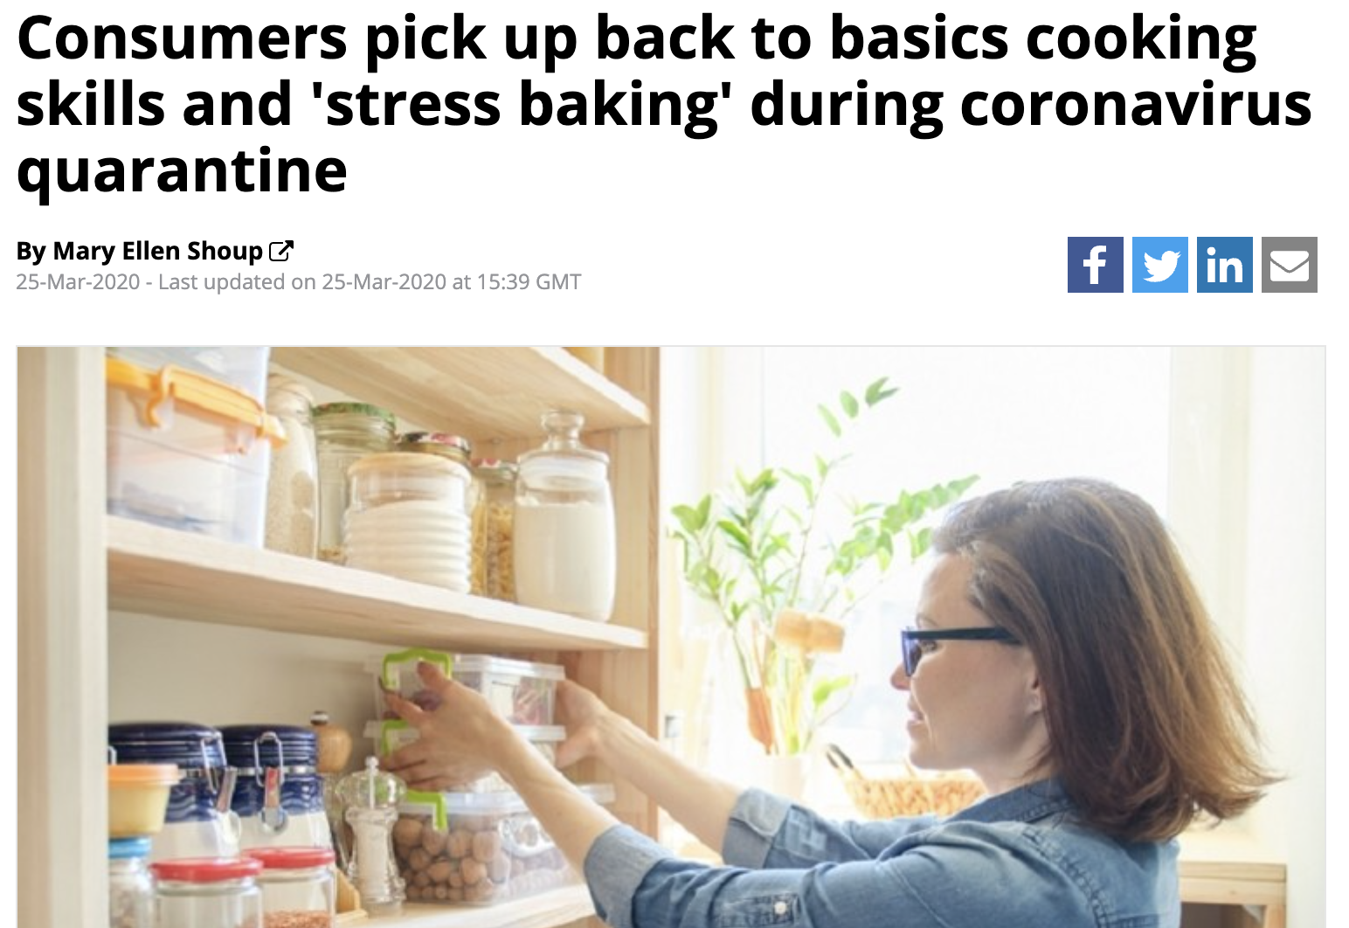
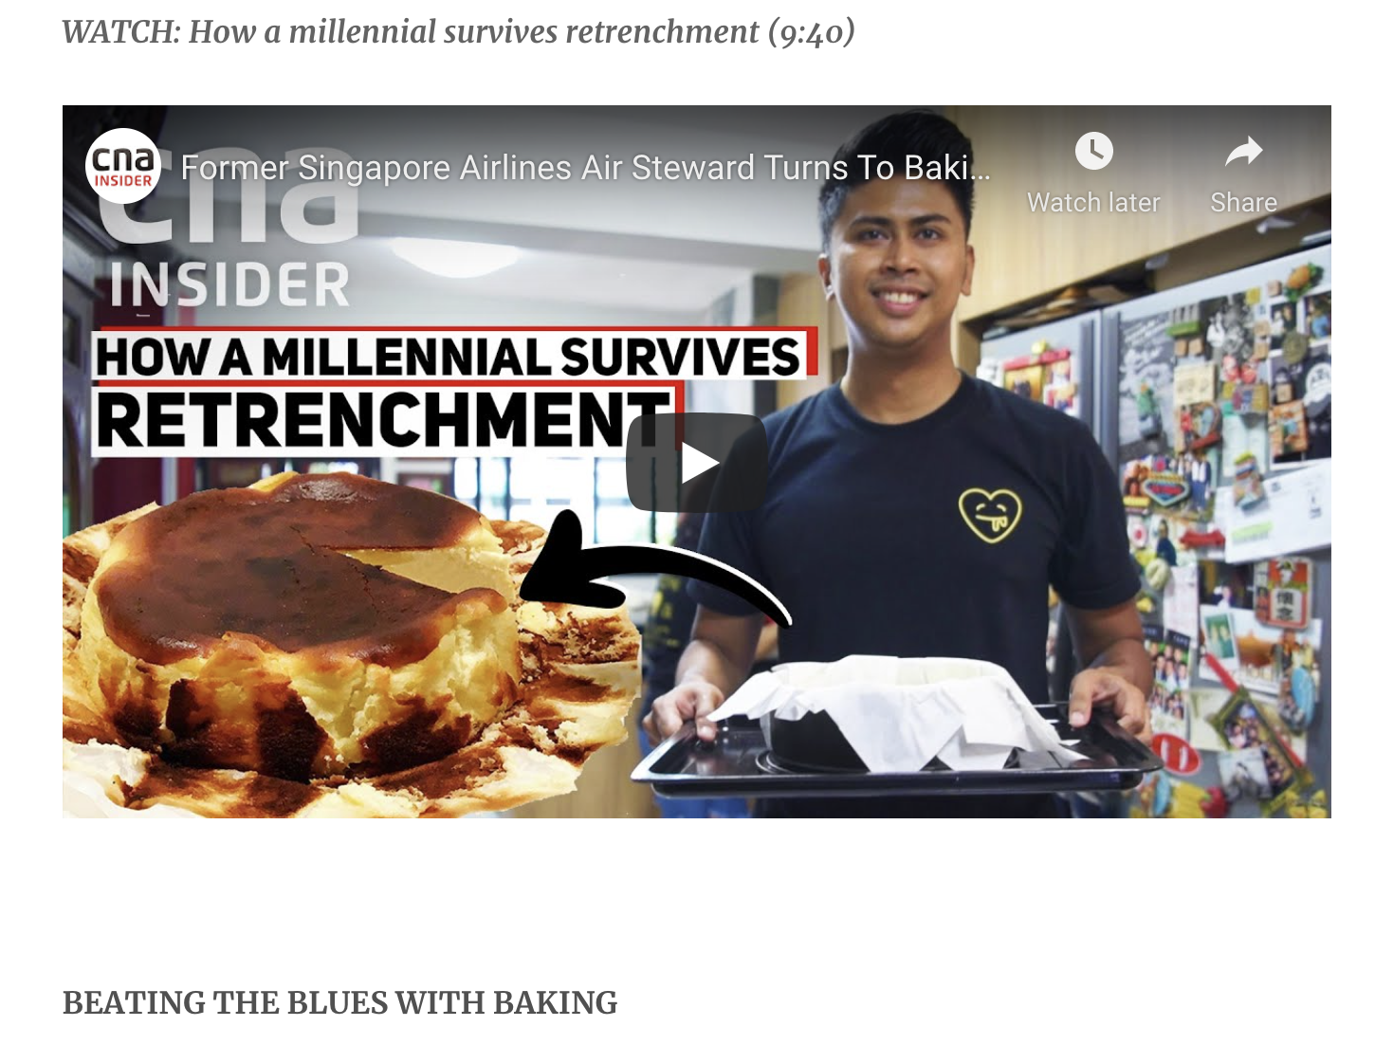
But when one road closes…

Slide 4
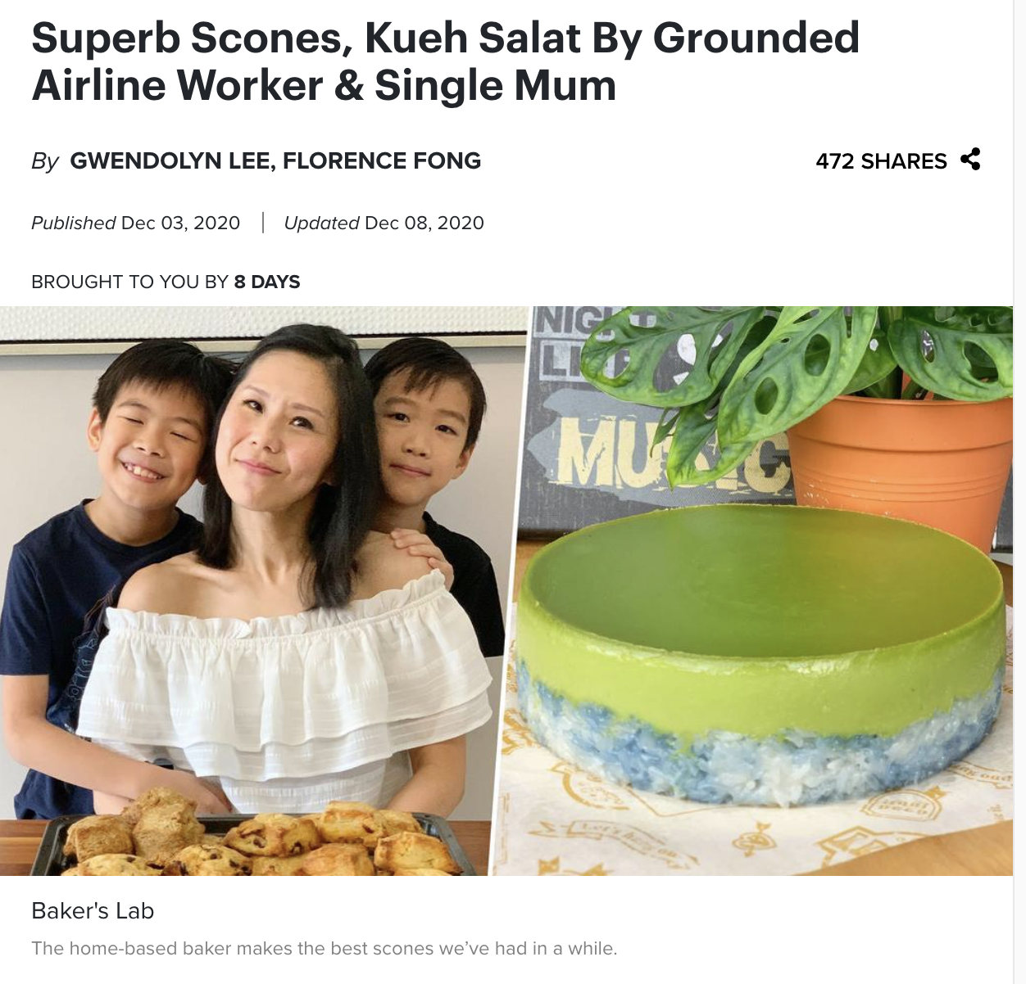
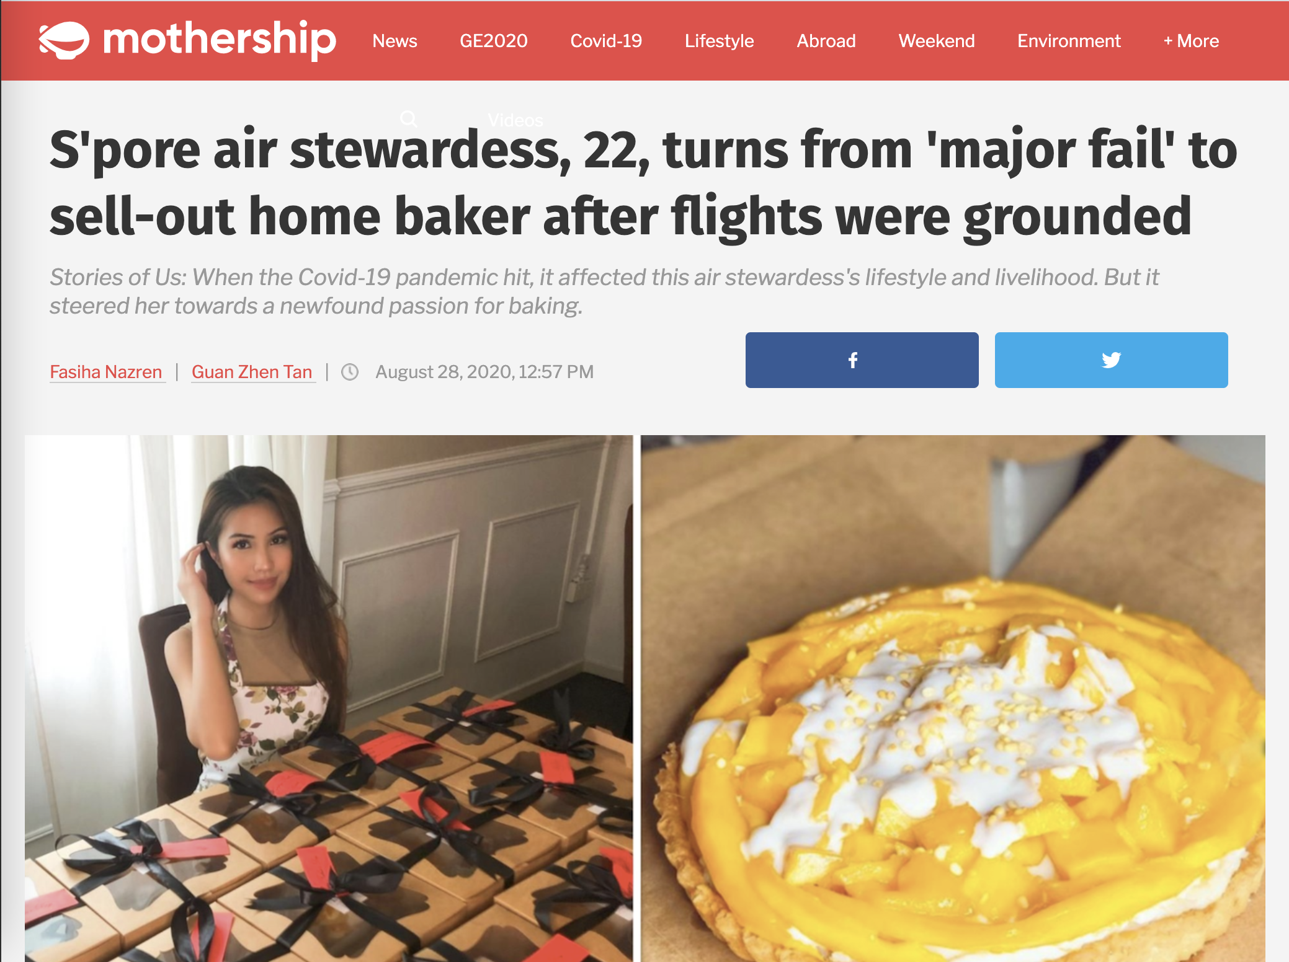
Another opens…

Slide 5
simpleStore
A simple eCommerce store for individuals to sell homemade goods
By Calvin Chew Ing Hao

Slide 6






Architecture
docker-compose sets up Webserver and API Server in two separate containers
Amazon Cognito
Browser
Webserver
API Server
Amazon RDS for
REST calls
html/template
+ Bootstrap 5
Amazon S3

Slide 7
Demo

Slide 8
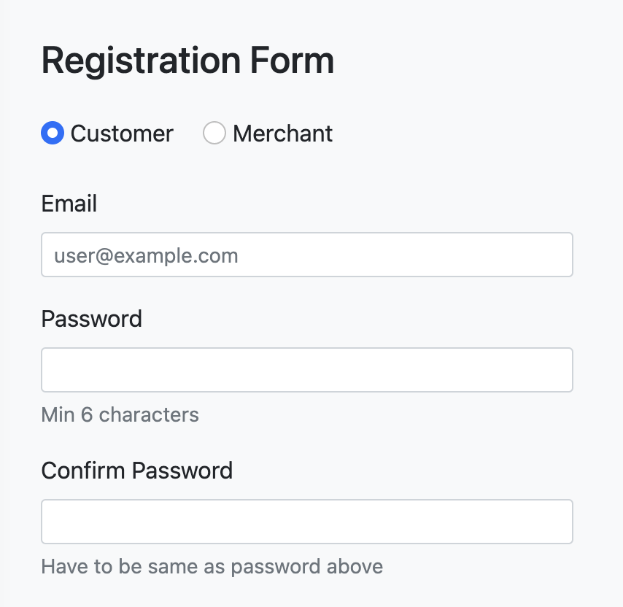
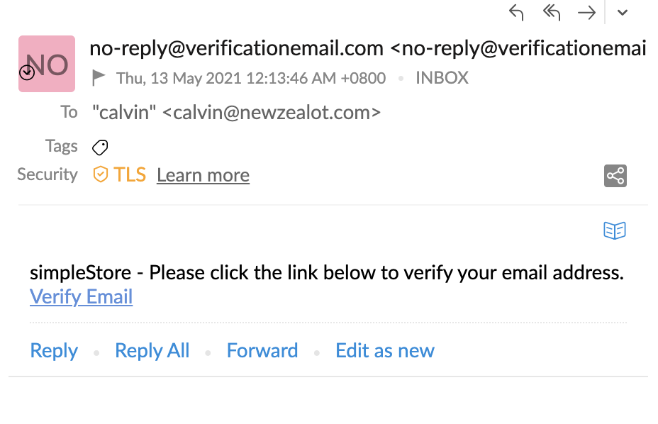
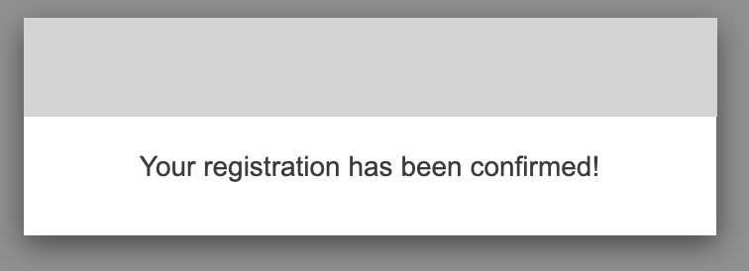
Registration
Amazon RDS for
UUID + Form
Browser
Webserver
API Server
Gorilla
CSRF
UUID
Form
Form
Form
Amazon Cognito
Verification Link
Verification Link Clicked

Slide 9
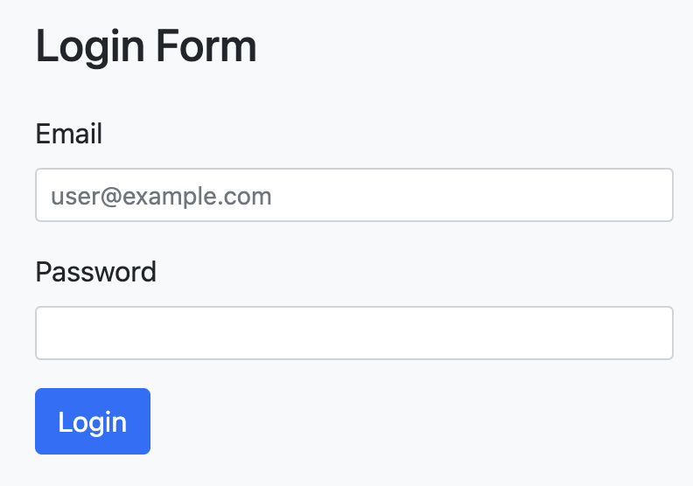

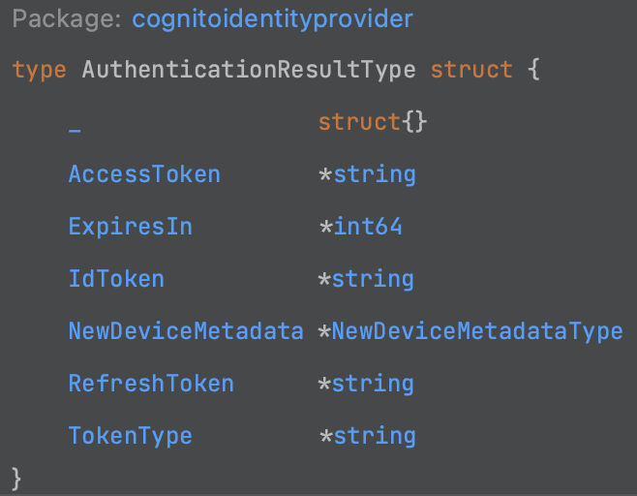


Login
Browser
Gorilla
CSRF
Webserver
API Server
Form
Form
Form
Amazon Cognito
json.Marshall
struct containing JWT tokens
RefreshToken
7 days expiry
IdToken
30 min expiry
AccessToken
30 min expiry

Slide 10

Routing - Valid Signed In
AccessToken
Browser
IdToken
Authorization Bearer
AccessToken
AllowOnlyMerchant
middleware
ValidateAccessToken
middleware
HandleFunc
/admin/*
Gorilla Mux
Gorilla Mux
AccessToken
IdToken
Authorization Bearer
AccessToken
AllowOnlyCustomer
middleware
ValidateAccessToken
middleware
HandleFunc
Gorilla Mux
/customer/*
Gorilla Mux
AccessToken
IdToken
GetUserInfo
middleware
HandleFunc
HandleFunc
Other routes
Gorilla Mux

Slide 11
Routing – RefreshToken present only
RefreshToken
Authorization Bearer
RefreshToken
Browser
/admin/*
/api/v1/refresh
AllowOnlyMerchant
middleware
RefreshHandler
struct
AccessToken
IdToken
Gorilla Mux
RefreshToken
Authorization Bearer
RefreshToken
/customer/*
/api/v1/refresh
RefreshHandler
AllowOnlyCustomer
middleware
struct
AccessToken
IdToken
Gorilla Mux

Slide 12
Routing – No Token
Browser
/admin/*
API Server
AllowOnlyMerchant
middleware
/login?error…
Gorilla Mux
/customer/*
AllowOnlyCustomer
middleware
Gorilla Mux
/login?error…
Other routes
GetUserInfo
middleware
HandleFunc
HandleFunc
Gorilla Mux

Slide 13
Product Add, Update or Delete
Browser
API Server
Amazon RDS for
Product Changes
Webserver
Product APIs…
Data
Checkout Changes
Checkout APIs…
Media Changes
Media APIs…
Files
Done
Done
Done
Amazon S3
Done
Done
Done

Slide 14
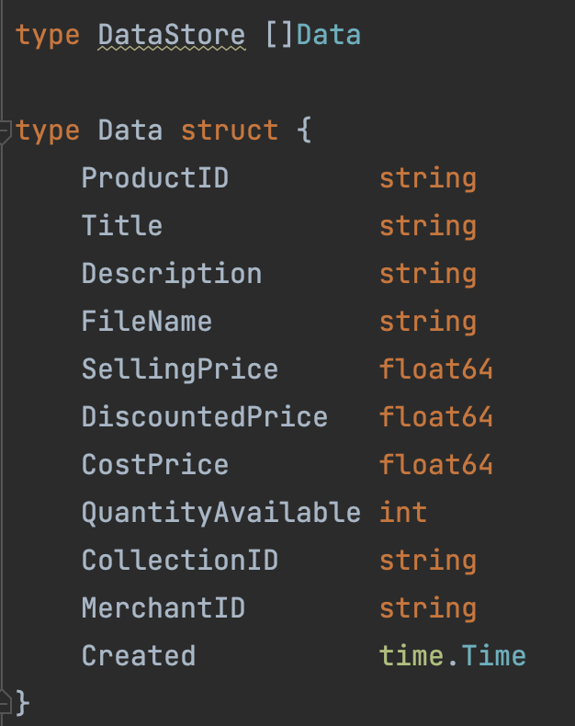
When Webserver starts, a copy of product data is stored in memory
var D DataStore
/api/v1/data
API Server
Amazon RDS for
Slice of Data struct

Slide 15
Subsequently, Webserver will serve GET requests from memory
Browser
/
Different filtering Receiver Functions
/collections/{id}
var D DataStore
/product/{id}
/admin

Slide 16
When a Non-GET request completes, a function is called to rebuild the memory
var D DataStore
/api/v1/data
API Server
Amazon RDS for
Slice of Data struct

Slide 17
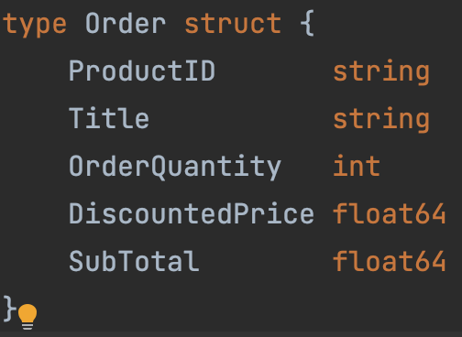

Cart Operations
Browser
Add to Cart
Buy Now
Webserver
Cart
json.Marshall
base64.StdEncoding.EncodeToString

Slide 18
Checkout Success
Amazon RDS for
AccessToken
IdToken
Cart
Browser
Webserver
API Server
Verify Price is same
Verify QuantityAvailable >=OrderQuantity
Slice of Order struct
json.Marshall
/api/v1/checkout
/customer/checkout
Insert Order Details
Update QuantityAvailable
Hosted Payment Page
Payment processing
checkout-success
/checkout-success?...

Slide 19
Checkout Cancelled
Amazon RDS for
AccessToken
IdToken
Cart
Browser
Webserver
API Server
Verify Price is same
Verify QuantityAvailable >=OrderQuantity
Slice of Order struct
json.Marshall
/api/v1/checkout
/customer/checkout
Insert Order Details
Update QuantityAvailable
Revert changes
Revert changes
Update QuantityAvailable
Update Order Status to “Cancelled”
Hosted Payment Page
Payment processing
checkout-success
/checkout-cancel?...

Slide 20
Q&A

Slide 21
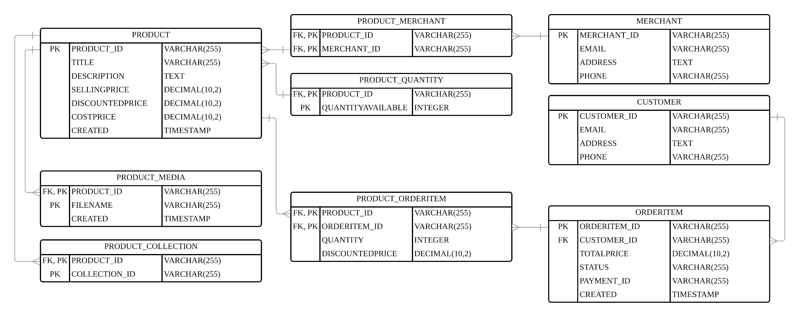
ER Diagram

Slide 22
